Slide 1
Maximizing the Usage of Value Vocabularies in the Linked Data Ecosystem:
The Case for Faceting
Ed O’Neill
OCLC Research
November 5, 2013
ASIS&T Montreal

Slide 2
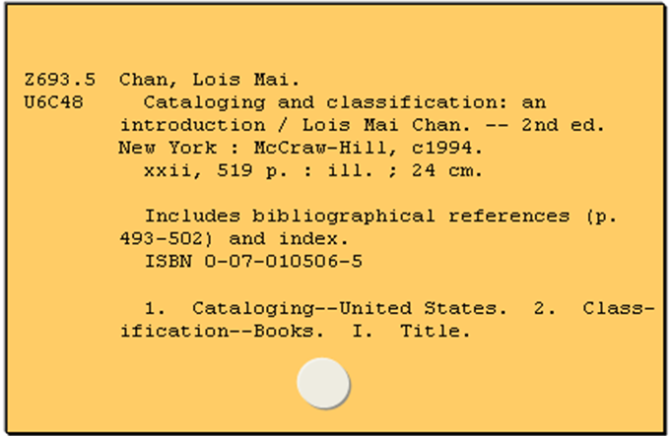
Old Environment
Notes:
Virtually all major subject categorization schema (LCC, DDC, LCSH. etc.) date back to the 1900s and were designed for card catalogs—not computer and certainly not to function as linked data.

Slide 3
FAST
The American Library Association’s ALCTS/SAC/Subcommittee on Metadata and Subject Analysis(1997-2001) recognized that a new schema is required for Internet resources and other non-traditional materials.
OCLC and the Library of Congress agreed to jointly develop FAST (Faceted Application of Subject Terminology) using the vocabulary from LCSH (Library of Congress Subject Headings).
FAST retains the LCSH vocabulary in eight facets: (1) Personal names, (2) Corporate names, (3) Events, (4) Titles, (5) Chronologicals, (6) Topicals, (7) Geographics, and (8) Form/Genre.
All FAST headings (except chronologicals) are established and linkable.
Notes:
The two schemas considered for adoption were LCSH and Sears

Slide 4
Links: to & from
Bibliographic Record
Authority Record
Other Authorities / Sources
Notes:
When discussing authorities, we need to consider two types of links; those that link to the authority and those that are linked to from the authority. Authority records are typically linked to from bibliographic records but often link to other related objects; Geonames, Dbpedia, VIAF, etc.) My talk focuses on what is required for a schema to be linked to. Jeff will review the links from as well as providing more details on the structure of the links.

Slide 5
Embedding vs. Linking
Embedding
Subject headings
sh 85129426
Linking
Notes:
A bibliographic can either (1) embed the heading from the authority into bibliographic record, (2) link to the authority record, or (3) embed the heading and link to the authority. The prevailing view is that for bibliographic data, we will transition from embedding to linking but currently embedding is the norm and is likely to remain so for some time.

Slide 6
Linking: Is Full Enumeration Required?
Synthetic: Only a set of core headings are established but those terms can be combined or extended following the synthetic rules. (LCSH)
Enumerative: All subject headings are established and included in the authority file. (FAST)
Notes:
Svenonius states that a language is enumerative if “all expressions in it that can be used for indexing or searching are listed in the vocabulary tool such as a thesaurus” and that all of its “expressions are editorially established—that is, established by the designer of the language rather than by the indexers who apply it.” LCSH is synthetic based schema; FAST is enumerative.

Slide 7
Linking as MARC Fields
LCSH:
650 0 $aSubject headings $0(DLC)sh 85129426
Source
ID
FAST:
650 7 $aSubject headings $2fast $0(OCoLC) fst01136458
Source
ID
Notes:
For compatibility with existing systems, for the immediate future, we will need to embed AND link.

Slide 8
Linking; A Simplified Example
010 2010015675
050 00 Z695.Z8 $b F373 2010
100 1 Chan, Lois Mai.
245 10 FAST : $b Faceted Application of Subject Terminology : principles and applications / $c Lois Mai Chan and Edward T. O'Neill.
260 Santa Barbara, Calif. : $b Libraries Unlimited,
$c c2010.
300 xvii, 354 p. : $b ill. ; $c 26 cm.
650 0
700 1 O'Neill, Edward T.
Subject headings
Subject headings $0(DLC)sh 85129426
$0(DLC)sh 85129426

Slide 9
Linked LCSH Authority Record
001 oca08527515
003 OCoLC
005 20131002170324.0
008 100609|| anannbabn |a ana
010 $ash2010008399
040 $aDLC$beng$cDLC
053 0 $aZ695.Z8.F37
150 $aFAST subject headings
450 $aFaceted Application of Subject Terminology subject headings
550 $aSubject headings$wg
670 $aWork cat.: 2010015675 ....
Notes:
By linking to the authority, in addition to obtaining the established form of the heading (even if it has changed) but an extensive set of the related information; geographic coordinates, classification, cross-references, links to other sources, etc.

Slide 10
LCSH Linking; 3 cases
Bibliographic
Authorities
Simple Link
Advertising—Automobiles
sh 85001092
Advertising—Automobiles
5.8%*
Love—Religious aspects—Buddhism, [Christianity, etc.]
No Link
Love—Religious aspects—Sikhism
sh 85078522
Burns and scalds
sh 85018164
Multiple Links
Burns and scalds—Patients
sh 00006930
Patients
*All Statistics as of 1/1/2013
Notes:
No simple link is possible for multiples; established headings that authorize multiple headings base on a pattern. Frequently, LCSH headings are build by combining several authority records. LCSH headings exist that combine at least five authorities.

Slide 11
Options for Simple Links
Faceting.
Validation records (Create authority records for all valid headings)
Hybrid (Link when possible, embedded otherwise)

Slide 12
5.8% of LCSH Headings are Established 24.8M are Unestablished
Notes:
For LCSH, Subjects includes name authorities that have been used as subjects.

Slide 13
LCSH Headings are Growing Rapidly
26,423,651 unique LCSH headings in WorldCat,
1,490,61 9 new LSCH headings were added to WorldCat in 2012,
1,586,961 of the unique LCSH headings are established,
59,895 of the LCSH headings were established in 2012.
Notes:
The NOCO normalization rules were used determine uniqueness; i.e. differences in spacing, capitalization, and diacritics were ignored.

Slide 14
Impact of Faceting
Geographics (651)
Conf. & Meetings (611)
Corporates (610)
Titles (630)
Persons (600)
Topicals (650)
FAST vs. LCSH
Notes:
There are approximately the same number of subject authorities but all FAST headings (except chronologicals) are established and linkable vs. less than 6% of LCSH headings.

Slide 15
Result of Faceting
26.5 million LCSH headings
→ 1.7 FAST headings

Slide 16
Maximizing the Usage of Value Vocabularies in the Linked Data Ecosystem:
FAST Linked Data Mechanics
Jeff Mixter
Research Support Specialist, OCLC Research
November 5, 2013
ASIS&T Montreal
@JeffMixter

Slide 17
Introduction
FAST Linked Data was first published December of 2011
Derived from MARC
It was developed using SKOS (Simple Knowledge Organization Schema)
Similar to Library of Congresses Linked Data project
SKOS is used to help bridge Controlled Vocabulary terms with conceptual Entities
FAST headings link to their respective Library of Congress heading(s)
FAST Geographic headings are linked to GeoNames
Allows for services such as mapFAST

Slide 18
FAST URIs in MARC Bibliographic Records
MARC is currently the data standard
Should not prevent libraries from accommodating Linked Data URIs
There is no way to actually imbed the FAST URIs into MARC
It is possible to add all of the needed information to generate a URI
Use of canonical identifiers
The MARC $0
Works well with FAST but is sometimes problematic for LCHS

Slide 19
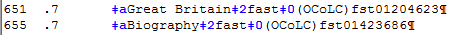
≠
canonical ID in the $0
http://id.worldcat.org/fast/1204623

Slide 20
Canonical URIs
On 2013-01-16 LC made the following changes to two name authority records
n 78081636 Stein, Jock --> Stein, Jock (Cleric)
no2012157653 Stein, Jock, Pulp fiction writer --> Stein, Jock
Of the 30 works that had Stein, Jock (n 78081636) as either a 100 or 700 entry only 3 were changed to Stein, Jock (Cleric)
LC practice prevents a 400 field from being used in n78081636 because it is now the valid 100 field heading no2012157653
It is now impossible to differentiate the two names
This change pattern occurred 840 times in 2012 alone

Slide 21
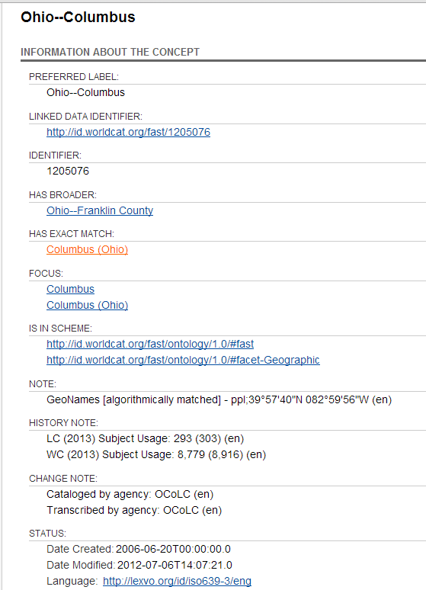
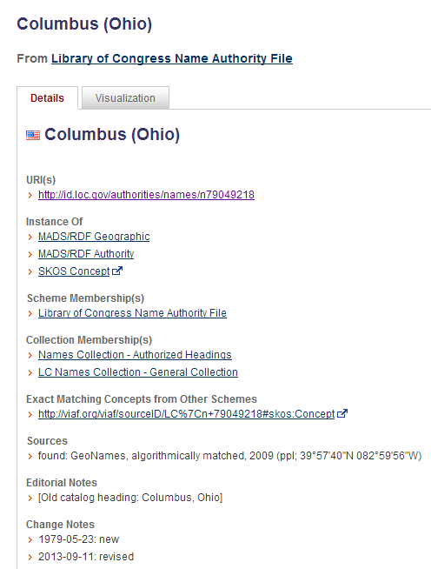
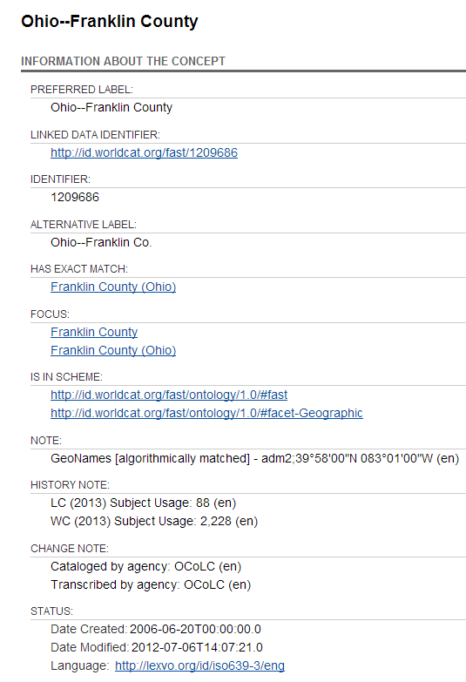
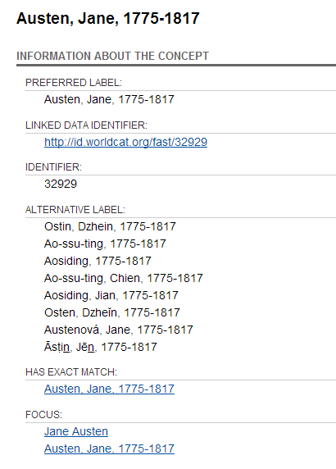


Slide 22
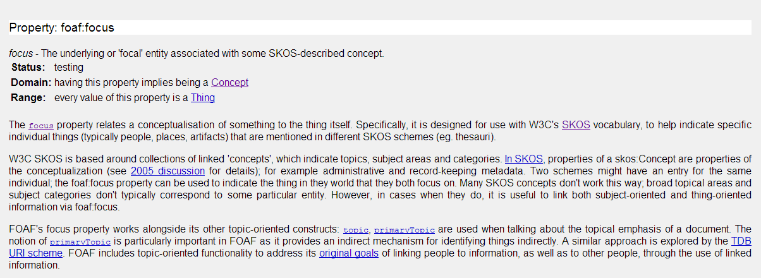
??? foaf:focus ???
“The focus property relates a conceptualization of something to the thing itself…” - http://xmlns.com/foaf/spec/#term_focus
Unique to the FAST and VIAF vocabulary
Allows FAST controlled headings to link to resources that represent/describe the real-world thing
The foaf:focus property highlights the problematic nature incorporating controlled vocabularies in Linked Data

Slide 23
Linking a skos:Concept to another skos:Concept
SKOS is very good at representing Controlled Vocabulary terms as RDF but is falls short when it comes to describing the type of Entity or Entity to Entity relationships
There is a constraint that prevents owl:sameAs from being used
In order to link two skos:Concepts one uses skos:exactMatch

Slide 24
Linking a skos:Concept to another skos:Concept
SKOS was designed with thesauri, controlled vocabularies, taxonomies etc. in mind
It would not be appropriate to say that one skos:Concept is literally the same as another skos:Concept
This would cause confusion as to what the preferred term was
All that can be claimed is that a skos:Concept in one ontology has an exact match that can be identified in another ontology

Slide 25
Linking skos:Concept to Real-World Things
SKOS only describes things as concepts that have preferred and alternative labels
This is very effective for describing the provenance of controlled terms
BUT…

Slide 26
Linking skos:Concept to Real-World Things
People are People and Places are Places
in order to describe something accurately they need to be labeled as those specific types of Things
foaf:focus allows FAST Controlled Vocabulary terms (skos:Concept) to be connected to URIs that identify real-world entities
VIAF, GeoNames and Dbpedia.org (represented as Wikipedia in the MARC record)
Machines can understand (reason) that a FAST controlled term is related to a real-world entity and allows human to gather more information about the entity that is being described

Slide 27
LCNAF
DNB
skos:exactMatch
foaf:focus
foaf:focus
skos:exactMatch
VIAF
skos:exactMatch
skos:exactMatch
skos:exactMatch
foaf:focus
foaf:focus
skos:exactMatch
LACNEF
Getty ULAN

Slide 28
The data is sparse
Preferred Label, Alternative Label and Identifier
To an end-user this is not very helpful
No data that a machine could harvest and use
This limits what can be done with the data
Link to dbpedia.org
Link to VIAF

Slide 29
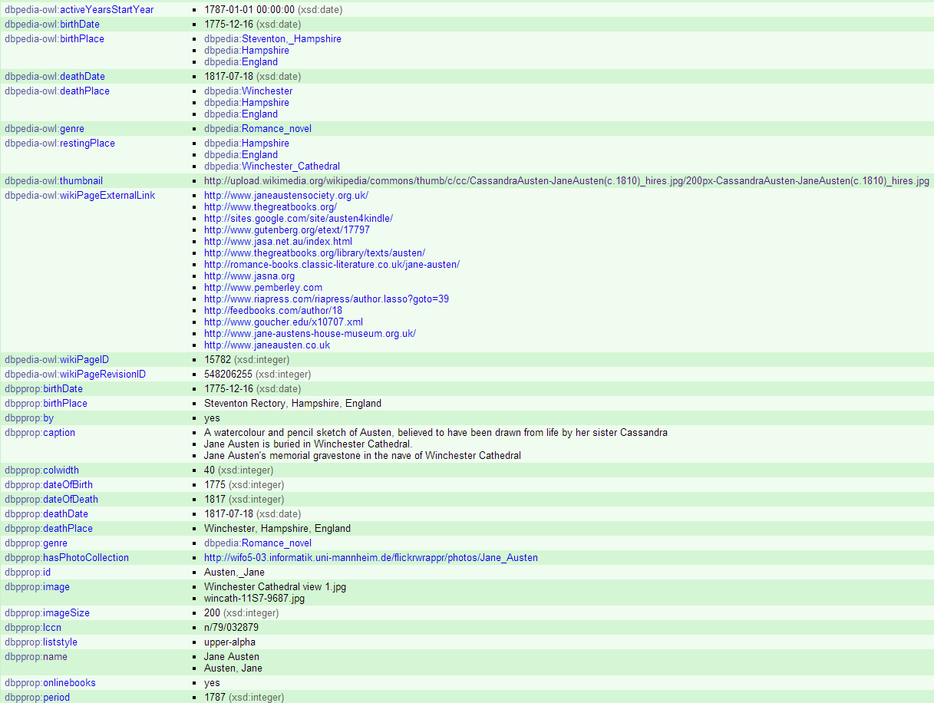

Slide 30
Use of foaf:focus in FAST
For authority data and bibliographic data, relying on information from sources such as dbpedia.org could be problematic
Accuracy of information
Noise – traditional cataloging practice
Using foaf:focus allows FAST to be used as a traditional Controlled Vocabulary (retain provenance over sting labels) while also allowing machines and humans to infer rich information about the Entity that is related to the skos:Concept

Slide 31
Ed O’Neill
oneill@oclc.org
Jeff Mixter
mixterj@oclc.org
@JeffMixter

